Slide 1
Time series forecasting
Machine learning way

Slide 2
Modeling and prediction
In the following examples, we try to explain the observations by adding up different factors.
Trend
Seasonality
Noise
Note that noise means unexplained part of our observations.

Slide 3
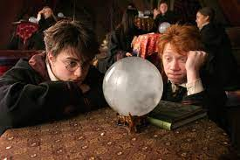
Forecasting
After we find an explanation of the pass, we can use the reasoning to forecast the future!
Important: Time series models are not prophecy balls. It cannot predict patterns that has never occurred in the past.

Slide 4
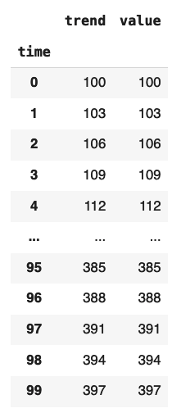
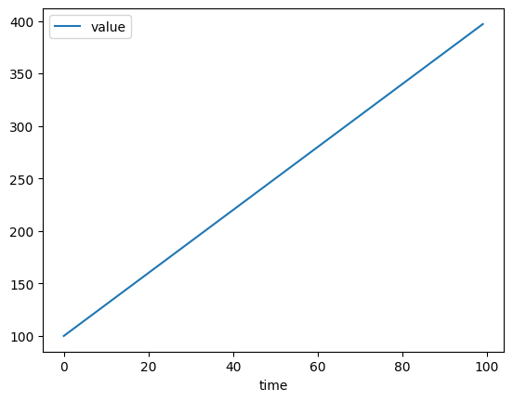
Example: Trend
Explanation:
Value is proportional to time. Starting from 100, +3 for each time step

Slide 5
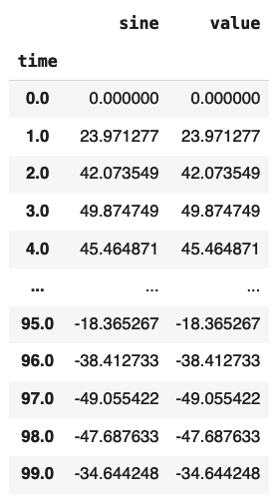
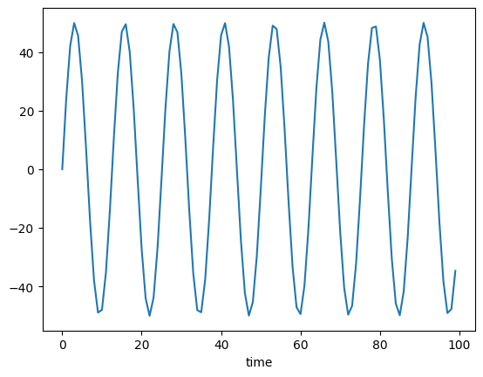
Example: Periodical
Explanation:
Value is changed in a periodical way, with a fixed magnitude and a fixed length of period. Roughly 8 cycles in 100 time steps.

Slide 6
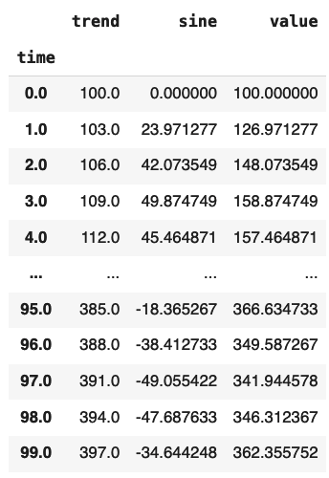
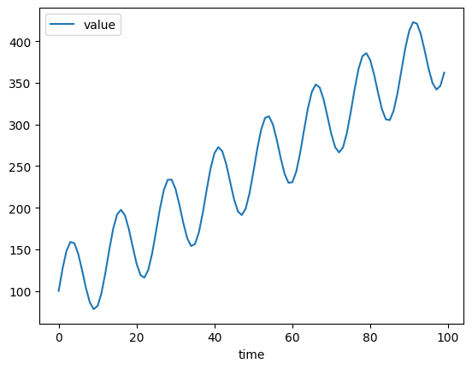
Example: Periodical + Trend
+
=
Explanation:
Value is affected by both
constant increase effect
seasonal effect
Two effects are independent of each other
(The magnitude of the seasonal effect remains the same when the trend factor change from 100 to 300)

Slide 7
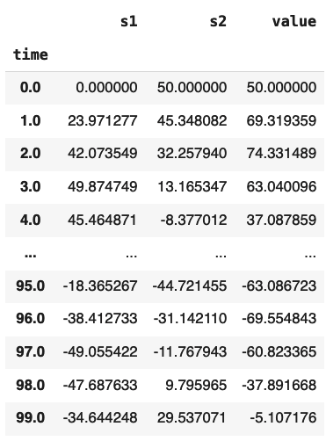
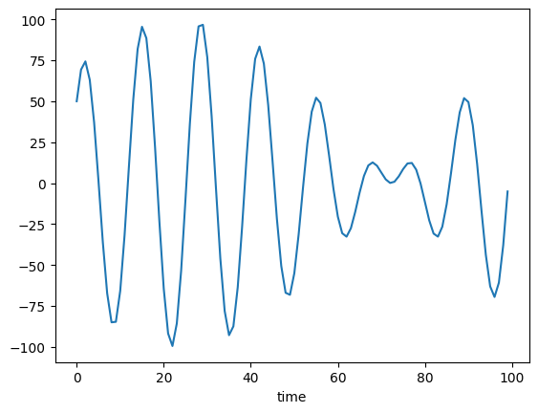
Example: Periodical 1 + Periodical 2
+
=
Explanation:
Value is affected by two seasonal effects

Slide 8
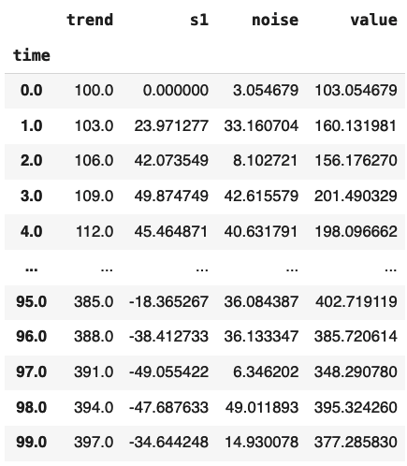
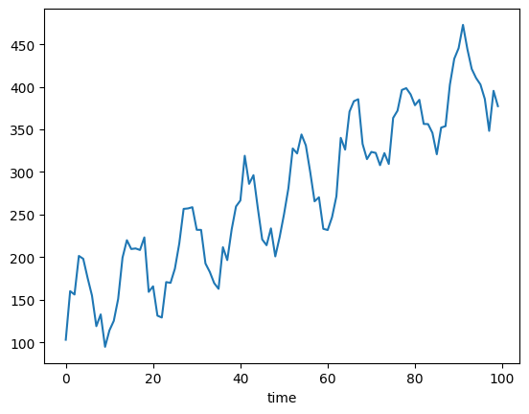
Example: Periodical + Trend + Noise
+
+
=
Explanation:
Value is affected by
constant increase effect
seasonal effect
Noise (= unexplained variations)

Slide 9
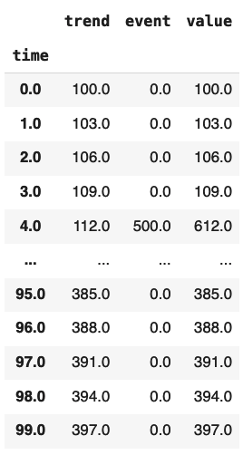
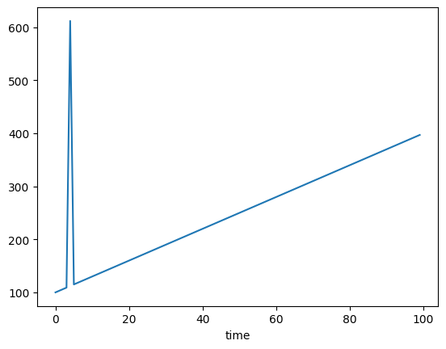
Example: Trend + Special events
+
=
Explanation:
Value is proportional to time, with special event happened at time=4

Slide 10
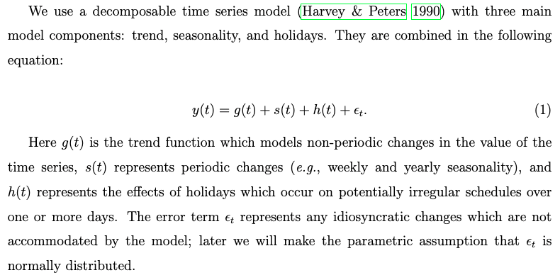
Time series modeling
Facebook prophet tries to explain the time series value by adding up different components.

Slide 11
Time series modeling procedures

Slide 12
Predicting the next value in a time series is a regression task
Observations
Prediction

Slide 13
Recall: Regression model
 | Features
1975-11-03
1975-11-04
1975-11-05 | ?
1975-11-06
1975-11-07
Label
104
321
232
551
133
Recall that we need to prepare features (X) and label (y) for training a regression model. Now the question become - what is the X?

Slide 14
Features for time series regression
There are some common features for time series regression. For each time step, we can provide the following features.
Number of time steps since start
Strength of a seasonal effect
Any special event
Last n steps observations (auto regressive)

Slide 15
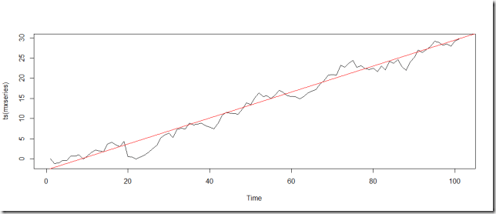
Features: Time step
Hypothesis:
The time series follows and oscillate around a trend (e.g. +3 unit per day)
 | Features
 | Day
1975-11-03 | 0
1975-11-04 | 1
1975-11-05 | 2
1975-11-06 | 3
1975-11-07 | 4
Label
321
232
551
233
304

Slide 16
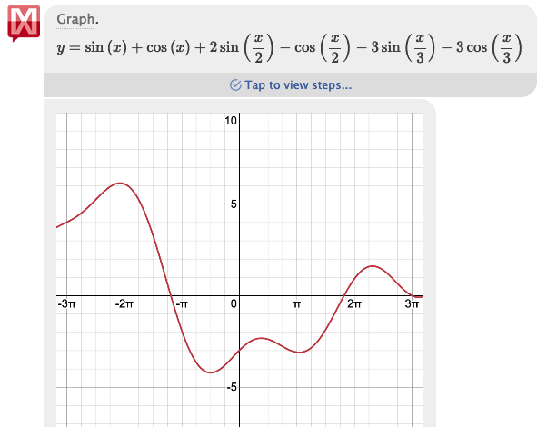
Features: Seasonal effect
Hypothesis: The oscillation of the time series is a combination of sine/cosine waves. Mathematically, we can prove that different sine and cosine waves can add up to form different patterns.
 | Features
 | day | sin(day) | cos(day) | sin(day/2) | cos(day/2) | …
1975-11-03 | 0
1975-11-04 | 1
1975-11-05 | 2
1975-11-06 | 3
1975-11-07 | 4
Label
321
232
551
233
304

Slide 17
Features: Events/Holiday
Hypothesis: Events and holidays can greatly impact the time series.
E.g. Sales is boosted due to a marketing campaign.
 | Features
 | day | sin(day) | cos(day) | sin(day/2) | cos(day/2) | Campaign
1975-11-03 | 0 |  |  |  |  | False
1975-11-04 | 1 |  |  |  |  | False
1975-11-05 | 2 |  |  |  |  | True
1975-11-06 | 3 |  |  |  |  | False
1975-11-07 | 4 |  |  |  |  | False
Label
321
232
551
233
304

Slide 18

Linear regression
So solve the parameters in this equation,
we can use Linear Regression.
Facebook prophet uses this mechanism (addition model) behind the scene.

Slide 19
Model evaluation

Slide 20
Evaluation - Mean Absolute Error (MAE)
Predicted
Actual
MAE is the average of all errors

Slide 21
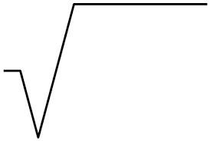
Evaluation - Root Mean Squared Error (RMSE)
Predicted
Actual
RMSE is the average of all squared errors
2
avg( )

Slide 22
Evaluation - Mean Absolute Scaled Error (MASE)
MASE = MAE of real prediction / MAE of naive prediction
MASE is a measurement of how much better is our model compared to the naive model.
Naive Prediction - Predict with previous value
Real Prediction - Predict with model

Slide 23
MASE vs R²
Both MASE and R² compare the prediction with a baseline prediction.
In R², the baseline prediction is the average value of all labels. Applicable to general regression task.
In MASE, the baseline prediction is the previous value of the time series. Applicable to regression of time series.

